Slide 1
NEURAL NETWORKS

Slide 2
Neural networks
Why do we need AI or artifical neural networks?
Computers can solve several poblems: graph-related problems (shortest path algorithms, spanning trees), sorting arrays or any kind of optimization problems // numerical methods
BUT there are other problems → that can not be defined with an exact mathematical algorithm
For example: facial recognition, language processsing ...
OK but for humans these problems seems much more easier than graph algorithms or solving differential equations with Runge-Kutta methods …

Slide 3
Neural networks
INTUITION: if we try to mimic how nervous system of a human works or how a human learns things → maybe we are able to achive these problems with computers as well
Basically this is why AI has came to be → we came to the conclusion that for several problems the orthodox approach is not feasible
This is how big data has came to be as well → we have huge datasets and the way we handled datasets in the past (relational databases) is not going to work this time

Slide 4
Neural networks
Inspired by biological neural networks
We represent each neuron with a node → it is basically a directed / undirected graph
Their design enables them to process information in a similar way to our own biological brains
Each edge has a weight
These neural networks are capable of learning by changing the weights of their connections !!!
Support vector machines and other simpler methods ( linear classifiers ) gradually overtook neural networks in machine learning popularity
With the advent of deep learning neural nets are becoming more and more popular again

Slide 5
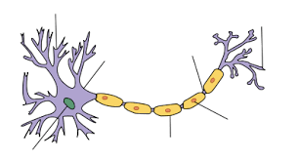
Neuron: neurons are the unit which the brain uses to process information
~ each neuron can make contact with several thousand other neurons
Neuron
Axon: transmit the electric signal from neuron
to neuron ~ basically connects the neurons !!!

Slide 6
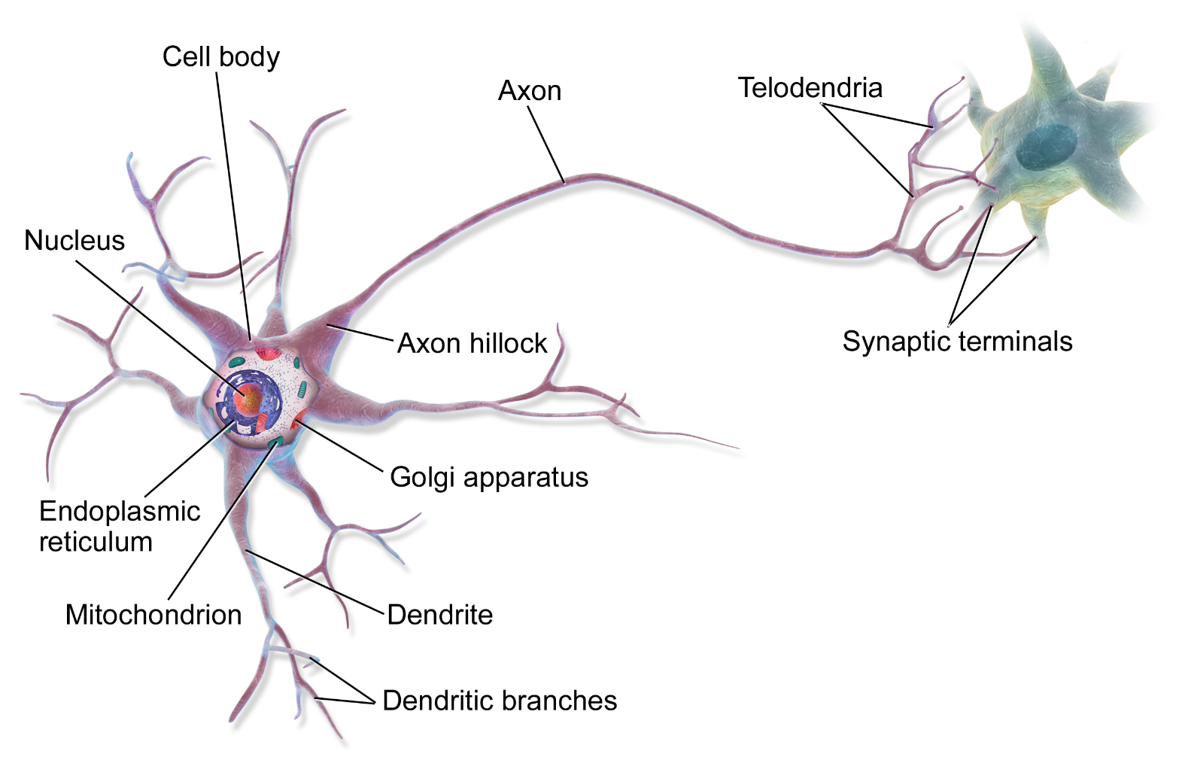
The boundary of the neuron is the so called cell membrane.
There is a voltage difference (the membrane potential) between
the inside and outside of the membrane
If the input is large enough, an action potential is then generated → with the help of the axon it can
reach several other neurons

Slide 7
Neurons only fire when input is larger than a given threshold
Important → firing doesn't get bigger as the stimulus increases,
its an all or nothing arrangement

Slide 9
Modeling the nature

Slide 10
Huge network of neurons and axons
INPUT
OUTPUT

Slide 11

We would like to construct an
algorithm that can conclude: it is
the number 7 !!!
This is the handwritten image we
want to recognize !!!
The approach is the same when we would like to recognize pedestrians while
driving or digitalize a handwritten book/article !!!

Slide 12
Neurons only fire when input is larger than a given threshold
Important → firing doesn't get bigger as the stimulus increases,
its an all or nothing arrangement
?
INPUT
OUTPUT

Slide 13
?
INPUT
OUTPUT
Model of nervous system → it is basically a graph with nodes ( neurons )
and the edges ( axons )

Slide 14
Model

Slide 15
Model
input layer

Slide 16
Model
hidden layer

Slide 17
Model
output layer

Slide 18
Input layer: we keep feeding our network with data through the
input layer
~ for example we have an image of a digit: we convert it to
RGB values so every pixel will have a numerical value.
So we have as many input neurons as the number of pixels in the image
Hidden layer: it is needed in order to make predictions when we
have non-linear problems
Output layer: we have the result here ~ the predicted digit

Slide 19
What is the input and the output?
?
INPUT
OUTPUT
For humans: we see a handwritten character → this is the input
Then we can recognize that character → that’s the output
For computers: of course we have to transform the image into numerical data, we
have to make a prediction what character it might be !!!

Slide 20
When to use neural networks?
Several problems can be solved with well defined algorithms: sorting numbers, multiplication, addition ...
Some problems can not be easily defined with an exact algorithm: facial recognition or OCR !!!
Most of the problems we try to solve with neural networks are quite trivial to humans

Slide 22
Learning paradigms

Slide 23
Supervised learning
The dataset we have has labels
So we know what results we are looking for
We train the network until we get the good results
For example: face recognition

Slide 24
AND logical relation
x
y
x AND y
0
0
0
0
1
0
1
0
0
1
1
1

Slide 25
Unsupervised learning
The dataset we have is not labeled
So we do NOT know what results we are looking for
The algorithm will figure out the pattern for us
For example: clustering algorithms

Slide 26
x
1
x
2

Slide 27
x
1
x
2

Slide 29
Model

Slide 30


Model
inputs
x1
weights
neurons
„perceptrons”
w1
x2
w2
activation
function
w3
$$Σ$$
$$f$$
x3
sum
function
.
.
.
wn
xn

Slide 31
Model
inputs
x1
weights
neurons
„perceptrons”
w1
x2
w2
activation
function
w3
$$Σ$$
$$f$$
x3
sum
function
.
.
.
wn
xn

Slide 32
Model
2.) sum up
the weights
3.) activation function gives
the output !!!
1.) we have the incoming
weights

Slide 33
Model
What are the edge weights good for?
They can amplify or deamplify the input signal
> 1 amplify
< 1 deamplify
inputs
x1
weights
neurons
„perceptrons”
w1
x2
w2
activation
function
w3
$$Σ$$
$$f$$
x3
sum
function
.
.
.
wn
xn

Slide 34

Model
Sum function: we have to multiply each input
with the given edge weight and have to add these
values together
inputs
x1
$$\sum_{i=0}^{n}{xi ∗wi}$$
weights
neurons
„perceptrons”
sum =
w1
x2
w2
activation
function
w3
$$Σ$$
$$f$$
x3
sum
function
.
.
.
wn
xn

Slide 35
Model
Activation function: going to convert the
output (sum). A step function activation
function will output 1 if the input is higher
than a certain threshold ... 0 otherwise
inputs
x1
weights
neurons
„perceptrons”
w1
x2
w2
activation
function
w3
$$Σ$$
$$f$$
x3
sum
function
.
.
.
wn
xn

Slide 36
Percepton: it is a neuron in the neural network
We have to sum up the weighted inputs
For perceptrons we use the step function with a
given threshold
~ it is not working fine for neural network training because
the output can be 0 or 1 for perceptrons
A small change in the weights or bias of any single perceptron in the network
can sometimes cause the output of that perceptron to completely flip ( 0 → 1 )
That flip may then cause the behaviour of the rest of the
network to completely change in some very complicated way
Sigmoid neuron: very similar to perceptrons
But small changes in the edge weights → cause small change
in the output // no flips here !!!
~ the inputs / outputs can take any values between 0 and 1 !!!

Slide 38
Activation functions

Slide 39
We have to apply one of these
activation functions on the sum we have
calculated previously !!!
y = sign(x)
y
+1
x
-1
„STEP FUNCTION”

Slide 40
We have to apply one of these
activation functions on the sum we have
calculated previously !!!
y = sign(x-a)
y
+1
a
x
-1
„STEP FUNCTION”

Slide 41
We have to apply one of these
activation functions on the sum we have
calculated previously !!!
y = sign(x)
y
+1
0
x
„STEP FUNCTION”

Slide 42
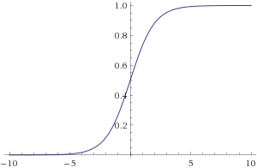
We have to apply one of these
activation functions on the sum we have
calculated previously !!!
1
y =
- x
1 + e
„SIGMOID FUNCTION”
The sigmoid function. The problem is that it does not have any negative value

Slide 43
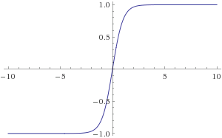
Hyperbolic tangent function
x
- x
e
- e
y =
x
- x
e
+ e
Sometimes it is better because it
can have negative values as well
„TANH FUNCTION”

Slide 45
The big picture

Slide 49
The information is encoded in the edge weights !!!

Slide 50
The information is encoded in the edge weights !!!
~ change in the edge weight → change in the output
w + Δw
o + Δo

Slide 51
The information is encoded in the edge weights !!!
~ change in the edge weight → change in the output
w + Δw
o + Δo
The algorithm keeps changing the edge weights → so that for the given inputs there
will be the right output in the output layer !!!

Slide 52
on every iteration the network gets a little closer to
be able to classify for example digits
we repeat the process several times: changing the weights
will produce better and better results
The network is learning !!!

Slide 54
Example
x1 = 1
w1 = 0.2
step function
w2 = - 0.5
$$Σ$$
$$f$$
x2 = 1
sum
function
w3 = 0.4
x3 = 0

Slide 55
Example
sum = x1*w1 + x2*w2 + x3*w3 = 1*0.2 + 1*(-0.5) + 0*0.4 = -0.3
stepFunction( -0.3 ) = 0 !!!
x1 = 1
w1 = 0.2
step function
w2 = - 0.5
$$Σ$$
$$f$$
x2 = 1
sum
function
w3 = 0.4
x3 = 0

Slide 56
Example
sum = x1*w1 + x2*w2 + x3*w3 = 1*0.2 + 1*(-0.5) + 0*0.4 = -0.3
stepFunction( -0.3 ) = 0 !!!
x1 = 1
w1 = 0.2
step function
w2 = - 0.5
$$Σ$$
$$f$$
0
x2 = 1
sum
function
w3 = 0.4
x3 = 0

Slide 57
Example
sum = x1*w1 + x2*w2 + x3*w3 = 1*0.2 + 1*0.5 + 1*0.7 = 1.4
stepFunction( 1.4 ) = 1 !!!
x1 = 1
w1 = 0.2
step function
w2 = 0.5
$$Σ$$
$$f$$
1
x2 = 1
sum
function
w3 = 0.7
x3 = 1

Slide 59
Applications of neural networks
Self driving cars + cars that are able to park themself without human intervention
Pattern recognition in healtcare industry → detect cancer or eye disorders well in advance
Pattern detection in stock markets in order to predict stock prices
Facial recognition
Natural language processing
In the united arab emirated AI has been used to control traffic → a system has been created that intelligently calculates traffic mishaps while consistently finding solutions to fix them

Slide 61
Feedforward neural network

Slide 62
Feedforward neural network
x
O
y
Output layer
Input layer
Hidden layer

Slide 63
x
y
Input layer
Output layer

Slide 64
x
Every node has a threshold T
If the incoming signal > T → the neuron
will fire !!!
w1
y
w2
Input layer
Output layer

Slide 65
AND logical relation
x
y
x AND y
0
0
0
0
1
0
1
0
0
1
1
1

Slide 66
x
Every node has a threshold T
If the incoming signal > T → the neuron
will fire !!!
w1
T=2
y
w2
Input layer
Output layer

Slide 67
x
w1 = 1.5
T=2
y
w2 = 1.5
Input layer
Output layer

Slide 68
When x=0 AND y=0 → the result should be 0
x=0
w1 = 1.5
T=2
y=0
w2 = 1.5
Input layer
Output layer

Slide 69
When x=0 AND y=0 → the result should be 0
x=0
w1 = 1.5
T=2
y=0
w2 = 1.5
Input layer
Output layer
Incoming signal to the output node: from x and from y
incomingSignal = xValue * w1 + yValue*w2
if ( incomingSignal > T ) → neuron will fire / produce a 1 !!!

Slide 70
When x=0 AND y=0 → the result should be 0
x=0
w1 = 1.5
T=2
y=0
w2 = 1.5
Input layer
Output layer
incomingSignal = 0*1.5 + 0*1.5 = 0

Slide 71
When x=0 AND y=0 → the result should be 0
x=0
w1 = 1.5
0
T=2
y=0
w2 = 1.5
Input layer
Output layer
incomingSignal = 0*1.5 + 0*1.5 = 0

Slide 72
When x=1 AND y=0 → the result should be 0
x=1
w1 = 1.5
0
T=2
y=0
w2 = 1.5
Input layer
Output layer
incomingSignal = 1*1.5 + 0*1.5 = 1.5

Slide 73
When x=0 AND y=1 → the result should be 0
x=0
w1 = 1.5
0
T=2
y=1
w2 = 1.5
Input layer
Output layer
incomingSignal = 0*1.5 + 1*1.5 = 1.5

Slide 74
When x=1 AND y=1 → the result should be 1
x=1
w1 = 1.5
1 !!!
T=2
y=1
w2 = 1.5
Input layer
Output layer
incomingSignal = 1*1.5 + 1*1.5 = 3

Slide 76
Optimization

Slide 77
Optimization
We usually use x to denote training inputs
x = ( x , x … x )
We denote the corresponding desire outputs by y = f(x)
For example: AND logical operator training data
1
2
n

Slide 78
AND logical relation
x
y
x AND y
0
0
0
0
1
0
1
0
0
1
1
1

Slide 79
Optimization
We usually use x to denote training input
x = ( x , x … x )
We denote the corresponding desire output by y = f(x)
For example: AND logical operator training data
1
2
n
--------------------------------------------------------------------------------------------------------------
In a neural network → we keep changing the edge weights so that the
output from the network approximates f(x)
We can measure how we are achieving the goal of
this approximation with a cost function

Slide 80

Optimization
2
C(w) = $\frac{1}{2n}$ $\sum_{x}{|\left|f\left(x\right)−y^{′}\right||}$
- y’ is the output from the neural network
f(x) is the output we know from the training data
this is a so-called cost function → mean squared error !!!
What is the intuition?
~ if C(w) is huge → it means there are huge errors in the sense that our
neural network does not produce the results we know from the dataset
~ if C(w) is low → it means the neural network is making good predictions
WE HAVE TO FIND THE MINIMA FOR THE COST FUNCTION !!!

Slide 81
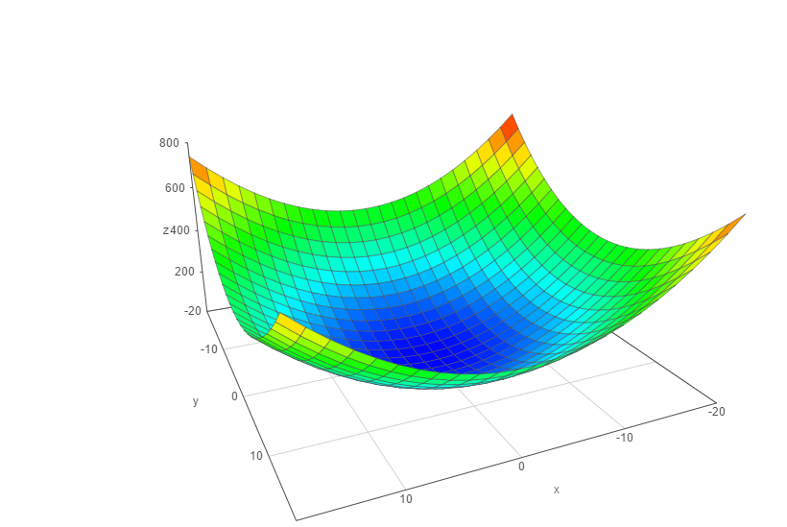
min C( w , w ... w )
w
1
2
n
w
1
w
2

Slide 82



How to find the minima of the cost-function?
1.) gradient descent
We have to know the partial derivative of the mean-squared error
and go to the direction of the gradient
// gradient ~ partial derivative
2.) backpropagation
It is a gradient descent implementation as well
~ the cost function can be defined as the average of all
the cost functions
// we assign a cost-function to every single training example
~ the cost function can be transformed into a form that it will be a function
of the output activations
$$\frac{∂MSE}{∂w}$$
$$\frac{∂MSE}{∂w}$$
$$\frac{∂MSE}{∂w}$$
…
1
2
n

Slide 84
Training our AND neural network

Slide 85
AND logical relation
x
y
x AND y
0
0
0
0
1
0
1
0
0
1
1
1

Slide 86
XOR logical relation
x
y
x XOR y
0
0
0
0
1
1
1
0
1
1
1
0

Slide 87
x
w1
y
w2
Problem: we do not know the correct edge weights in advance
We initialize it with a random number

Slide 88
x
w1 = 2
T=2
y
w2 = 3

Slide 89
x
y
x AND y
x
w1 = 2
0
0
0
0
1
0
T=2
1
0
0
1
1
1
y
w2 = 3
„ideal”

Slide 90
x
y
x AND y
0
0
0
x
y
x AND y
0
1
1
x
1
0
1
w1 = 2
0
0
0
1
1
1
0
1
0
T=2
1
0
0
„actual”
1
1
1
y
w2 = 3
„ideal”
incomingSignal = sum ( neuronValue * weight )

Slide 91
x
w1 = 2
T=2
y
w2 = 3

Slide 92
We construct the training data from out AND logical table. We have 4 (x,y) pairs with
the right answer: we can train out network according to these data
x
w1 = 2
T=2
y
w2 = 3

Slide 93
If (x,y) is (0,0) the correct answer is 0. We test it on our network: there will be probably
an error due to the random weights !!!
X=0
w1 = 2
T=2
y=0
w2 = 3

Slide 94
If (x,y) is (0,0) the correct answer is 0. We test it on our network: there will be probably
an error due to the random weights !!!
X=0
w1 = 2
T=2
y=0
w2 = 3
incomingSignal = 0*2 + 0*3 = 0
Expected according to the logic table: 0
Result: 0
Error: 0

Slide 95
Error calculation
The simplest algorithm: error = rightAnswer – calculatedAnswer
Better approach: ( rightAnswer – calculatedAnswer )
We run our algorithm until theses error terms are very small !!!
We keep updating the edge weights
weight(n+1) = weight(n) + input * error * learningRate ( < 1 )
2

Slide 96
If (x,y) is (1,0) the correct answer is 0. We test it on our network: there will be probably
an error due to the random weights !!!
X=1
w1 = 2
T=2
y=0
w2 = 3
incomingSignal = 1*2 + 0*3 = 2
Expected according to the logic table: 0
Result: 1 // because incomingSignal >= T
Error: 0-1 = -1

Slide 97
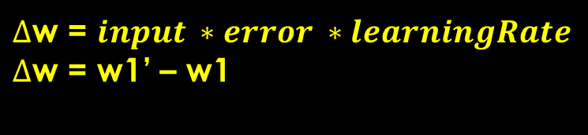
We have to update the weight !!!
w1’ = w1 + 1 * (-1) * 0.1
w2’ = w2 + 0 * (-1) * 0.1
$∆$w = $input ∗error ∗learningRate$
$∆$w = w1’ – w1
X=1
w1 = 2
T=2
y=0
w2 = 3
incomingSignal = 1*2 + 0*3 = 2
Expected according to the logic table: 0
Result: 1 // because incomingSignal >= T
Error: 0-1 = -1

Slide 98
We have to update the weight !!!
w1’ = w1 + 1 * (-1) * 0.1
w2’ = w2 + 0 * (-1) * 0.1
X=1
w1 = 1.9
T=2
y=0
w2 = 3
incomingSignal = 1*2 + 0*3 = 2
Expected according to the logic table: 0
Result: 1 // because incomingSignal >= T
Error: 0-1 = -1

Slide 100
Output layer
Input layer
Hidden layer

Slide 101
x
y

Slide 102
1
1
x
y
We always need a bias ( with value 1 ): to be able to control the output

Slide 103
Bias unit
Sometimes we want to get not zero output even if the inputs are all zeros. Basically
we can shift the activation function with bias units

Slide 104
1
1
w1
w10
w2
w3
w11
x
w4
w5
w6
w12
w7
y
w8
w9
w13
We always need a bias ( with value 1 ): to be able to control the output

Slide 105
1
1
1
1
1
2
x
2
1.5
1
-2.5
2
0.5
y
2
1
1.5

Slide 106
1
1
1
A
1
1
2
x
2
1.5
1
-2.5
B
2
0.5
y
2
1
C
1.5
How we are able to compute the values for A, B, C? We have to sum up the neuron values
multiply by the edge weights accordingly !!!

Slide 107
1
1
1
A
1
1
2
x
2
1.5
1
-2.5
B
2
0.5
y
2
1
C
1.5

Slide 108
1
1
1
A
1
1
2
x
2
1.5
1
-2.5
B
2
0.5
y
2
1
C
1.5
tempA = biasNode*biasWeight + xValue * xWeightToA + yValue*yWeightToA

Slide 109
1
1
1
A
1
1
2
X=1
2
1.5
1
-2.5
B
2
0.5
Y=0
2
1
C
1.5
tempA = 1*1 + 1*2 + 0*0.5 = 3

Slide 110
We have to use activation functions to calculate the activation
level of the neurons: it yields whether the given neuron will fire or not !!!

Slide 111
1
1
1
A
1
1
2
X=1
2
1.5
1
-2.5
B
2
0.5
Y=0
2
1
C
1.5
tempA = 1*1 + 1*2 + 0*0.5 = 3 → sign(tempA) = +1 !!!

Slide 112
1
1
1
A=1
1
1
2
X=1
2
1.5
1
-2.5
B
2
0.5
Y=0
2
1
C
1.5
tempA = 1*1 + 1*2 + 0*0.5 = 3 → sign(tempA) = +1 !!!

Slide 113
1
1
1
A=1
1
1
2
X=1
2
1.5
1
-2.5
B
2
0.5
Y=0
2
1
C
1.5
tempB = bias * biasWeight + xValue * xWeightToB + yValue * yWeightToB

Slide 114
1
1
1
A=1
1
1
2
X=1
2
1.5
1
-2.5
B
2
0.5
Y=0
2
1
C
1.5
tempB = 1 * 2 + 1 * 1 + 0 * 2 = 3

Slide 115
1
1
1
A=1
1
1
2
X=1
2
1.5
1
-2.5
B=1
2
0.5
Y=0
2
1
C
1.5
tempB = 1 * 2 + 1 * 1 + 0 * 2 = 3 → sign(tempB) = +1

Slide 116
1
1
1
A=1
1
1
2
X=1
2
1.5
1
-2.5
B=1
2
0.5
Y=0
2
1
C
1.5
tempB =bias * biasWeight + xValue * xWeightToC + yValue * yWeightToC

Slide 117
1
1
1
A=1
1
1
2
X=1
2
1.5
1
-2.5
B=1
2
0.5
Y=0
2
1
C
1.5
tempB = 1 * 1,5 + 1 * (-2.5) + 0 * 1 = -1

Slide 118
1
1
1
A=1
1
1
2
X=1
2
1.5
1
-2.5
B=1
2
0.5
Y=0
2
1
C=-1
1.5
tempB = 1 * 1,5 + 1 * (-2.5) + 0 * 1 = -1 → sign(tempC) = -1

Slide 119
1
1
1
A=1
1
1
2
X=1
2
1.5
1
-2.5
B=1
2
0.5
Y=0
2
1
C=-1
1.5

Slide 120
1
1
1
A=1
1
1
2
X=1
2
1.5
1
-2.5
B=1
2
0.5
Y=0
2
1
C=-1
1.5
tempOutput = biasValue * biasWeight + valueA * weightA + ...

Slide 121
1
1
1
A=1
1
1
2
X=1
2
1.5
1
-2.5
B=1
2
0.5
Y=0
2
1
C=-1
1.5
tempOutput = 1 * 1 + 1 * 1 + 1 * 2 + (-1) * 1.5 = 2.5

Slide 122
1
1
1
A=1
1
1
2
X=1
2
1.5
1
-2.5
B=1
2
+1
0.5
Y=0
2
1
C=-1
1.5
tempOutput = 1 * 1 + 1 * 1 + 1 * 2 + (-1) * 1.5 = 2.5 → sign(tempOutput) = +1

Slide 124
y
x

Slide 125
y
x

Slide 126
We have trainig data: (x,y) pairs + whether it is under the line
or not
y
x

Slide 127
y
x

Slide 128
After training our neural network: if we have a (x,y) pair, we can predict
whether it is under the line or not
y
x

Slide 129
Single-layer network:
If we have a linearly separable problem
~ a single-layer network is fine
Multi-layer network:
If we have a non-linear classification problem
~ we have to use multi-layer network

Slide 130
AND problem
XOR problem
y
y
1
0
0
1
1
0
1
0
0
0
0
1
x
x
0 1
0 1
This is a linearly separable problem,
no hidden layer needed
This is a non-linearly separable problem,
no linear line can be found to separate 0 from 1
Hidden layer needed in the network !!!!

Slide 132
The algorithm
1.) Initialize the edge weights at random
2.) Calculate the error: we have some training data and some results
x
y
x XOR y
The inputs are the (x,y) pairs: we
calculate the sum values and
acivation functions → we get a
value (output)
Output not always the ideal output
from the logical table !!!
// thats why we have errors
0
0
0
0
1
1
1
0
1
1
1
0
3.) Calculate the changes of the edge weights and update the weights. This is
the backpropagation process !!!
4.) The algorithm terminates when the network error is small

Slide 133
XOR problem
x
y

Slide 134
XOR problem
Initialize the weights at random
x
y

Slide 135
XOR problem
0.1
0.78
x
0.4
-0.22
0.5
0.35
y
-0.78
0.43
-0.4

Slide 136

XOR problem
We run our network on the
training data
0
$$\sum_{i=0}^{n}{xi ∗wi}$$
0.78
sum =
0.1
0
0.4
-0.22
0
0.5
0.35
0
-0.78
0.43
-0.4
0

Slide 137
XOR problem
We run our network on the
training data
0
$$\sum_{i=0}^{n}{xi ∗wi}$$
0.78
sum =
0.1
0
0.4
-0.22
0
0.5
0
0.35
0
-0.78
The output is 0.
the ideal value according
the table is 0 too
Error: 0 !!!
0.43
-0.4
0

Slide 138
XOR problem
We run our network on the
training data again
$$\sum_{i=0}^{n}{xi ∗wi}$$
0.78
sum =
0.1
0
0.4
-0.22
0.5
0.35
1
-0.78
0.43
-0.4

Slide 139
XOR problem
We run our network on the
training data again
1
$$\sum_{i=0}^{n}{xi ∗wi}$$
0.78
sum =
0.1
0
0.4
-0.22
0.5
0.35
1
-0.78
0.43
-0.4
sum = 0*0.1 + 1*0.35 = 0.35
stepFunction( 0.35 ) = 1

Slide 140
XOR problem
We run our network on the
training data again
1
$$\sum_{i=0}^{n}{xi ∗wi}$$
0.78
sum =
0.1
0
0.4
-0.22
0
0.5
0.35
1
-0.78
0.43
-0.4
sum = 0*0.4 + 1*(-0.78) = -0.78
stepFunction( -0.78 ) = 0

Slide 141
XOR problem
We run our network on the
training data again
1
$$\sum_{i=0}^{n}{xi ∗wi}$$
0.78
sum =
0.1
0
0.4
-0.22
0
0.5
0.35
1
-0.78
0.43
-0.4
1
sum = 0*(-0.22) + 1*(0.43) = 0.43
stepFunction( 0.43 ) = 1

Slide 142
XOR problem
We run our network on the
training data again
1
$$\sum_{i=0}^{n}{xi ∗wi}$$
0.78
sum =
0.1
0
0.4
-0.22
0
0.5
0
0.35
1
-0.78
0.43
-0.4
1
sum = 1*0.78 +0*0.5 + 1*(-0.4) = -0.38
stepFunction( -0.38 ) = 0

Slide 143
Run our neural net on
the training data
We get the calculated output
This is the forward process
( we have the ideal output because
it is a supervised learning method )
Update the edge weights accordingly
// calculate gradients, use
learning rate and momentum etc ...
Calculate the error term:
calculatedOutput - idealOutput

Slide 144
XOR problem
We run our network on the
training data again
0.35
$$\sum_{i=0}^{n}{xi ∗wi}$$
0.78
sum =
0.1
1
0.4
-0.22
-0.78
0.5
0
0.35
1
-0.78
0.43
Ideal: 1 ( from the table )
Calculated: 0
Error: not zero !!!
We have to update the weights
-0.4
0.43

Slide 145
Bias inputs are always 1 but the edge weights have random
values at the beginning and we have to update them accordingly
1
1
0.35
0.1
0.78
0
0.4
-0.22
-0.78
0.5
-0.29
0.35
1
-0.78
0.43
-0.4
0.43

Slide 147
Error calculation
Input idealOutput / trainingTarget actualOutput
0 0 0 0.3
0 1 1 0.2
1 0 1 0.4
1 1 0 0.5

Slide 148

Error calculation
Input idealOutput / trainingTarget actualOutput
0 0 0 0.3
0 1 1 0.2
1 0 1 0.4
1 1 0 0.5
$$\frac{1}{n}\sum_{i=1}^{n}{{(ideal\left(i\right)−actual\left(i\right))}^{2}}$$
Mean square error: „MSE”

Slide 149
Error calculation
Input idealOutput / trainingTarget actualOutput
0 0 0 0.3
0 1 1 0.2
1 0 1 0.4
1 1 0 0.5
Mean square error: „MSE”
${{{{\frac{1}{4} ( (0−0.3)}^{2}+(1−0.2)}^{2}+(1−0.4)}^{2}+(0−0.5)}^{2}$ )

Slide 150

Error calculation
Input idealOutput / trainingTarget actualOutput
0 0 0 0.3
0 1 1 0.2
1 0 1 0.4
1 1 0 0.5
$$\sqrt{\frac{1}{n}\sum_{i=1}^{n}{{(ideal\left(i\right)−actual\left(i\right))}^{2}}}$$
Root mean square error: „RMSE”

Slide 151

Error calculation
Input idealOutput / trainingTarget actualOutput
0 0 0 0.3
0 1 1 0.2
1 0 1 0.4
1 1 0 0.5
$=\sqrt{{\frac{1}{4}( {(0−0.3)}^{2}+(1−0.2)}^{2}+{(1−0.4)}^{2}{+(0−0.5)}^{\begin{aligned}2 \\ \end{aligned}}}$
it is the square root
of mean square error
„RMSE”
)

Slide 153
Gradient calculation
The problem with equations: f( w1, w2 ... wn ) = MSE
// if we change the weights the MSE will change too !!!
min C( w1, w2 ... wn ) C() measures the error !!!
w
Because we have several weights, the problem will be an optimization
problem in high dimensions
- brute force search for the optimal solution is not working
because of the enormous search space
- simulated annealing and genetic algorithms give us an
approximation ... which is good most of the time !!!

Slide 154
Gradient calculation
We have to calculate the gradient to know how much we
should adjust the edge weights
f(w) = MSE
w

Slide 155

Gradient calculation
We have to calculate the gradient to know how much we
should adjust the edge weights
MSE
we have to calculate
the slope of the curve
with partial derivatives
$$\frac{∂MSE}{∂w}$$
direction of
the gradient
w

Slide 156
Gradient calculation
For every node we have to calculate the so called delta parameter
// it is essential for getting the gradient
We need the deriative of the activation function
public double void sigmoid(double x){
return 1 / (1 +Math.exp(-x));
}
public double dSigmoid(double x){
return ( sigmoid(x)*(1-sigmoid(x)) );
}
1
y =
- x
1 + e
„sigmoid function”

Slide 157
Gradient calculation
Calculate the delta for the output layer:
deltaOutput = - E * dSigmoid(sum)
error
term
derivative of the
activation function
// sometimes the error term is defined differently
E = actual – ideal OR E = ideal - actual

Slide 158
Gradient calculation
Calculate the delta for the output layer:
deltaOutput = - E * dSigmoid(sum)
error
term
derivative of the
activation function
w1=-0.22
sum=-0.51
output=0.33
w2=0.15
sum=0.217
output=0.76

Slide 159
Gradient calculation
Calculate the delta for the output layer:
deltaOutput = - E * dSigmoid(sum)
error
term
derivative of the
activation function
w1=-0.22
sum=-0.51
output=0.33
sum = 0.33*(-0.22)+0.76*0.15 = 0.0414
output=sigmoid(sum)
ideal: should be 1 ( training data !!!! )
w2=0.15
sum=0.217
output=0.76

Slide 160

Gradient calculation
Calculate the delta for the output layer:
deltaOutput = - E * dSigmoid(sum)
error
term
derivative of the
activation function
w1=-0.22
sum=-0.51
output=0.33
sum = 0.33*(-0.22)+0.76*0.15 = 0.0414
output=sigmoid(sum) = 0.51
ideal: should be 1 ( training data !!!! )
w2=0.15
E = actual – ideal = 0.51 – 1 = -0.49
$δ=0.49 ∗dSigmoid\left(0.0414\right)=$0.49 * 0.249 = 0.122
sum=0.217
output=0.76

Slide 161

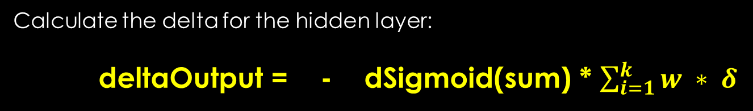

Gradient calculation
Calculate the delta for the hidden layer:
deltaOutput = - dSigmoid(sum) * $\sum_{i=1}^{k}{w ∗ δ}$
derivative of the
activation function
weights and the
previous layer delta
w1=-0.22
sum=-0.51
output=0.33
$δ=$0.122
w2=0.15
$δ$ = - dSigmoid(-0.51) * ( -0.22 * 0.122 ) = -0.234 * (-0.0268) =
= 0.006
sum=0.217
output=0.76

Slide 162
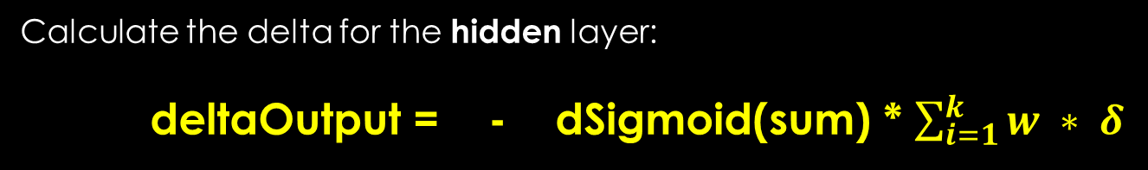
Gradient calculation
Calculate the delta for the hidden layer:
deltaOutput = - dSigmoid(sum) * $\sum_{i=1}^{k}{w ∗ δ}$
derivative of the
activation function
weights and the
pevious layer delta
w1=-0.22
sum=-0.51
output=0.33
$δ=$0.122
w2=0.15
$δ$ = - dSigmoid(-0.51) * ( -0.22 * 0.122 ) = -0.234 * (-0.0268) =
= 0.006
sum=0.217
output=0.76
IMPORTANT: we do not have to calculate the node deltas for
bias nodes and input nodes !!!

Slide 163


Gradient calculation
Calculate the gradients:
$$\frac{∂MSE}{∂w}$$
= $δ$
* input
derivative by edge weight
activation of
the neuron input
node delta at
the output node
Why is it good? BACKPROPAGATION !!!

Slide 165





Backpropagation
$∆$w
=
$α$
$$\frac{∂MSE}{∂w}$$
+ $μ$ *
$∆$w
t
*
t-1
t
previous change
in edge weight from
previous iteration
change in edge weight
at time t
learning rate
momentum
gradient

Slide 166





Backpropagation
$∆$w
=
$α$
$$\frac{∂MSE}{∂w}$$
+ $μ$ *
$∆$w
t
*
t-1
t
Learning rate: ~ 0.3
Define how fast our algorithm will learn
If it is too high: converge fast but not will be accurate, it may
miss global optimum
If it is too low: algorithm will be slow but more accurate !!!
Momentum: ~ 0.6
We can escape local minimas with this ( do not always work )
Define how much we are relying on the previous change, simply
adds a fraction of the previous weight update to the current one
High: helps to increase the speed of convergence of the system, but
it can overshoot the minimum
Too low: cannot avoid local optimums and slows down the training

Slide 168
Backpropagation

Slide 169
Backpropagation

Slide 170
Backpropagation

Slide 171
Backpropagation

Slide 172
Backpropagation

Slide 173
Backpropagation
This is the forward stage: we feed our neural net with the input data and
calculate the output !!!

Slide 174
Backpropagation

Slide 175
Backpropagation

Slide 176
Backpropagation

Slide 177
Backpropagation

Slide 178
Backpropagation

Slide 179
Backpropagation
This is the backward process: we update the edge weights starting
from the output layer !!!

Slide 181
Resilient propagation

Slide 182
Resilient propagation
It can be used to train neural networks as well
It has some advantages over backpropagation:
Usually faster than backpropagation
We do not have to specify extra parameters such as learning rate and momentum
Disadvantage: very hard to implement efficiently

Slide 183
Resilient propagation
It is an iterative approach as well: we have training epochs
Resilient propagation relies heavily on the gradients as well
The idea is that you must have some measure of error and that the value of the error will change as the value of one weight changes //assuming we hold the values of the other weights and biases the same

Slide 184
Resilient propagation
We have to calculate the gradient to know how much we
should adjust the edge weights
MSE
we have to calculate
the slope of the curve
with partial derivatives
$$\frac{∂MSE}{∂w}$$
direction of
the gradient
w

Slide 185
Resilient propagation
We have to calculate the gradient to know how much we
should adjust the edge weights
MSE
we have to calculate
the slope of the curve
with partial derivatives
$$\frac{∂MSE}{∂w}$$
direction of
the gradient
w

Slide 186
Resilient propagation
Negative slope: go in the positive weight direction
Positive slope: go in the negative weight direction
The steepness / magnitude of the slope: good hint how rapidly the
error is changing and how far to move to get a smaller MSE
MSE
we have to calculate
the slope of the curve
with partial derivatives
$$\frac{∂MSE}{∂w}$$
direction of
the gradient
w

Slide 187
Resilient propagation
Backprop: uses the magnitude to determine how to change the weights
Problem: the algorithm can overshoot the minimum
Oscillations occur !!! ~ missing the local optimum
OK we could use a smaller learning rate but the algorithms will
be slower !!!
MSE
we have to calculate
the slope of the curve
with partial derivatives
$$\frac{∂MSE}{∂w}$$
direction of
the gradient
w

Slide 188
Resilient propagation
Resilient propagation does not use the magnitude of the gradient to determine a weight delta
Instead it relies on the sign of the gradient ( + or - ) !!!
Instead of using a single learning rate for all weights and biases, resilient propagation uses separate weight deltas for each weight and bias and adapts these deltas during training

Slide 190
Applications of neural networks

Slide 191
Optical character recognition
We have an image and want to find out what character it is
Input layer:
For example we have a 8x8 pixel image ( 64 pixels )
In this situation we have 64 input neuron
Output layer
We have 26 output neurons because in the english alphabet there are 26 characters

Slide 193
new float[] {0,1,1,1,0,0,1,0,1,0,0,1,1,1,0,0,0,0,1,0,0,1,1,1,0};

Slide 194
We usually encode the output in binary
zero → 1 0 0 0 0 0 0 0 0 0
one → 0 1 0 0 0 0 0 0 0 0
two → 0 0 1 0 0 0 0 0 0 0
three → 0 0 0 1 0 0 0 0 0 0
four → 0 0 0 0 1 0 0 0 0 0
.
.
.

Slide 196
Stock market forecast
Stock price
time

Slide 197
Stock market forecast
Stock price
We construct a training data,
3 data points + the next one
We want to make prediction if
we have 3 points → what will
be the stock price tomorrow?
time

Slide 198
Stock market forecast
Stock price
#1 price
#2 price
#3 price
predict
time

Slide 199
Stock market forecast
Stock price
#1 price
#2 price
#3 price
predict
p11
time

Slide 200
Stock market forecast
Stock price
#1 price
#2 price
#3 price
predict
p11
p12
time

Slide 201
Stock market forecast
Stock price
#1 price
#2 price
#3 price
predict
p11
p12
p13
time

Slide 202
Stock market forecast
Stock price
#1 price
#2 price
#3 price
predict
p11
p12
p13
P1
time

Slide 203
Stock market forecast
Stock price
#1 price
#2 price
#3 price
predict
p11
p12
p13
P1
time

Slide 204
Stock market forecast
Stock price
#1 price
#2 price
#3 price
predict
p11
p12
p13
P1
p21
time

Slide 205
Stock market forecast
Stock price
#1 price
#2 price
#3 price
predict
p11
p12
p13
P1
p21
p22
time

Slide 206
Stock market forecast
Stock price
#1 price
#2 price
#3 price
predict
p11
p12
p13
P1
p21
p22
p23
time

Slide 207
Stock market forecast
Stock price
#1 price
#2 price
#3 price
predict
p11
p12
p13
P1
p21
p22
p23
P2
time

Slide 208
Stock market forecast
Stock price
#1 price
#2 price
#3 price
predict
p11
p12
p13
P1
p21
p22
p23
P2
time

Slide 209
Stock market forecast
Stock price
#1 price
#2 price
#3 price
predict
p11
p12
p13
P1
p21
p22
p23
P2
p31
p32
p33
P3
time

Slide 210
Stock market forecast
Stock price
#1 price
#2 price
#3 price
predict
p11
p12
p13
P1
p21
p22
p23
P2
p31
p32
p33
P3
p41
p42
p43
P4
time

Slide 211
Stock market forecast
Stock price
#1 price
#2 price
#3 price
predict
p11
p12
p13
P1
p21
p22
p23
P2
p31
p32
p33
P3
p41
p42
p43
P4
x
y
z
?
time
We train our neural network on these data: if we provide (x,y,z) three previous
values → it may predict the stock price tomorrow !!!

Slide 213
NEURAL NETWORKS
DEEP learning

Slide 214
Deep learning
In the ’90s → support vector machines proved to be better solutions for learning
There was not any efficient algorithms to train a neural net
Since 2006: several neural network training mechanisms were created
Neural networks outperform any other maching learning technique!!!
For example: in optical character recognition

Slide 215
complex, sophisticated
algorithms
<
simple learning algorithm + good training data

Slide 216
Deep learning
For example: face recognition
Networks with many-layer structure (two or more hidden layers) are called deep neural networks
New techniques allow to train 5 or 10 hidden layers !!!
It turns out that these deep networks perform far better on many problems than shallow neural networks
DEEP LEARNING CONCEPT

Slide 218
Problems
We are not able to use the same techniques as we have seen for shallow neural networks
The first hidden layer or the last hidden layer can be trained but not the others
„vanishing gradient problem”
Solution → not to use sigmoid function as an activation function

Slide 220
HOPFIELD NETWORKS

Slide 221
Hopfield network
A Hopfield network is a form of recurrent artificial neural network created by John Hopfield in 1974
They are guaranteed to converge to a minima
But convergence to a false pattern (wrong local optimum) rather than the stored pattern (global optimum) can occur
Basically a directed graph
Applications: able to recall patterns ( for example image recognition )

Slide 222
Feedforward network: edges are always pointing in the direction
of the next layer !!!
w1
w1
w2
w3
w4

Slide 223
Hopfield network: fully connected graph basically !!!
Neurons can have +1 / - 1 activations !!!
w =
w
1
w1
-1
w1
ij
ji
Symmetric
w3
w5
w2
w6
1
-1
w4

Slide 224

Unit states
Edge pointing from node i to node j
The strenght of the connection at a given time
$$\left\{\begin{aligned} +1 if \sum_{j}{w s > θ} \\ −1 otherwise\end{aligned}\right.$$
S =
ij
i
i
Threshold value for unit i
State of unit i

Slide 225

Unit states
Edge pointing from node i to node j
The strenght of the connection at a given time
$$\left\{\begin{aligned} +1 if \sum_{j}{w s > θ} \\ −1 otherwise\end{aligned}\right.$$
S =
ij
i
i
Threshold value for unit i
State of unit i
- the values of neuron i and neuron j will converge if the
weight between them is positive
- values will diverge if the weight is negative

Slide 227
Energy
we assign a scalar value to every single state of
the Hopfield network
1
w1
1
w1
w3
w5
w2
w6
1
1
w4

Slide 228
Energy
we assign a scalar value to every single state of
the Hopfield network
-1
w1
-1
w1
w3
w5
w2
w6
-1
-1
w4

Slide 229
Energy
we assign a scalar value to every single state of
the Hopfield network
-1
w1
1
w1
w3
w5
w2
w6
1
-1
w4

Slide 230


Energy
we assign a scalar value to every single state of
the Hopfield network
- $\frac{1}{2}$
$$\sum_{\begin{aligned}i,j \\ i<j\end{aligned}}{w s s}$$
E =
ij
i j
activation of neuron j
activation of neuron i
The lower the energy, the better !!!

Slide 231
Energy
we assign a scalar value to every single state / configuration of
the Hopfield network
- $\frac{1}{2}$
$$\sum_{\begin{aligned}i,j \\ i<j\end{aligned}}{w s s}$$
E =
ij
i j
The lower the energy, the better !!!
energy
If we keep updating the network
it will eventually converge to a state
which is the local / global optimum
Why is it good? Because we can
recall patterns. Using energy minima to
represent memories
states

Slide 233
Training
we should lower the energy of the network to be able to recall patterns
The network at that state will act as an autoassociative memory: it recalls
memories on the basis of similarity
( 1 0 0 1 1 ) training data → we train with this data, this will be the
energy minima
If we provide this pattern again for the trained network: it will
remember this sequence ( which means it is going to echo back
the pattern we have provided)

Slide 234

Learning
1949: Hebbian learning method
It is a method how to change the connections strengths in the network
Learning rate
$∆$w = $α$ x x
State / activation of unit j
ij
i
j
Change in weight connection from
node i to node j
State / activation of unit i

Slide 235

Learning
$∆$w = $α$ x x
ij
i
j
„Neurons that fire together will be wired together”
- if the two neurons are equal in sign: it has a positive effect on the connection. The value of i and j will tend to become equal
- if the two neurons are not equal in sign: quite the opposite
effect !!!
- it is not an error based learning method
- it is unsupervised: not train the network to an ideal output. It just reinforces what the network already knows

Slide 237
Problems
energy
First pattern at a
global minimum
Third pattern at a
global minimum
Second pattern at a
global minimum

Slide 238
Problems
Spurious states: local minimums
energy
First pattern at a
global minimum
Third pattern at a
global minimum
Second pattern at a
global minimum

Slide 239
Problems
Spurious states: local minimums
energy
The more pattern we want to train out network with: the more spurious states will occur
Whats the problem? The network may converge to this local minimas,
and will not be able to recall patterns any more !!!
PROBLEM !!!

Slide 241
Example
( 1 0 1 0 ) this is the pattern we want to recognize

Slide 242
Example
( 1 0 1 0 ) this is the pattern we want to recognize
1.) we have to convert it to a bipolar format: -1 and +1 form
2.) we have to calculate a weight matrix for this pattern: with outer product
( 1 0 1 0 ) → ( 1 -1 1 -1 )

Slide 243
Example
( 1 0 1 0 ) this is the pattern we want to recognize
1.) we have to convert it to a bipolar format: -1 and +1 form
2.) we have to calculate a weight matrix for this pattern: with outer product
( 1 0 1 0 ) → ( 1 -1 1 -1 )
1 -1 1 -1
1 1
-1
1
-1

Slide 244
Example
( 1 0 1 0 ) this is the pattern we want to recognize
1.) we have to convert it to a bipolar format: -1 and +1 form
2.) we have to calculate a weight matrix for this pattern: with outer product
( 1 0 1 0 ) → ( 1 -1 1 -1 )
1 -1 1 -1
1 1 -1
-1
1
-1

Slide 245
Example
( 1 0 1 0 ) this is the pattern we want to recognize
1.) we have to convert it to a bipolar format: -1 and +1 form
2.) we have to calculate a weight matrix for this pattern: with outer product
( 1 0 1 0 ) → ( 1 -1 1 -1 )
1 -1 1 -1
1 1 -1 1
-1
1
-1

Slide 246
Example
( 1 0 1 0 ) this is the pattern we want to recognize
1.) we have to convert it to a bipolar format: -1 and +1 form
2.) we have to calculate a weight matrix for this pattern: with outer product
( 1 0 1 0 ) → ( 1 -1 1 -1 )
1 -1 1 -1
1 1 -1 1 -1
-1 -1 1 -1 1
1 1 -1 1 -1
-1 -1 1 -1 1
It is a symmetric matrix !!!

Slide 247
Example
( 1 0 1 0 ) this is the pattern we want to recognize
3.) we have to set the diagonal elements to be equal to zero, because
there are no loops ( no neuron is connected to itself )
0 -1 1 -1
-1 0 -1 1
1 -1 0 -1
-1 1 -1 0
It is a symmetric matrix !!!
This matrix will define the configuration: if we present the initial pattern to this
matrix → the output will be the input itself ( pattern recalled !!! )

Slide 248
Example
( 1 0 1 0 ) this is the pattern we want to recognize
0 -1 1 -1
-1 0 -1 1
1 -1 0 -1
-1 1 -1 0
1
0
1
0
1
-2
1
-2
=
1
-2
1
-2
1
0
1
0
The output is the same as the
input, so we have managed to
recall the pattern !!!
Important: this matrix will recall the
inverse of the pattern as well
( 0 1 0 1 ) !!!
sgn =

Slide 250
Program structure

Slide 252
1
1

Slide 253
1
class NeuralNetwork {
Layer[] layers;
run(input) ...
train(input, output, alpha, mu) ...
}
1

Slide 254
1
class Layer {
input[]
output[]
weights[]
dWeights[]
run(input) ...
train(error, alpha, mu) ...
}
1

Slide 255
1
How to assign index to each weight?
~ because we need the edge weights to
calculate the output in the next layer
We should group the indexes
by the output neurons !!!
1

Slide 257
AND logical relation
x
y
x AND y
0
0
0
0
1
0
1
0
0
1
1
1

Slide 258
XOR logical relation
x
y
x XOR y
0
0
0
0
1
1
1
0
1
1
1
0

Slide 259
OR logical relation
x
y
x OR y
0
0
0
0
1
1
1
0
1
1
1
1

